Slide 1
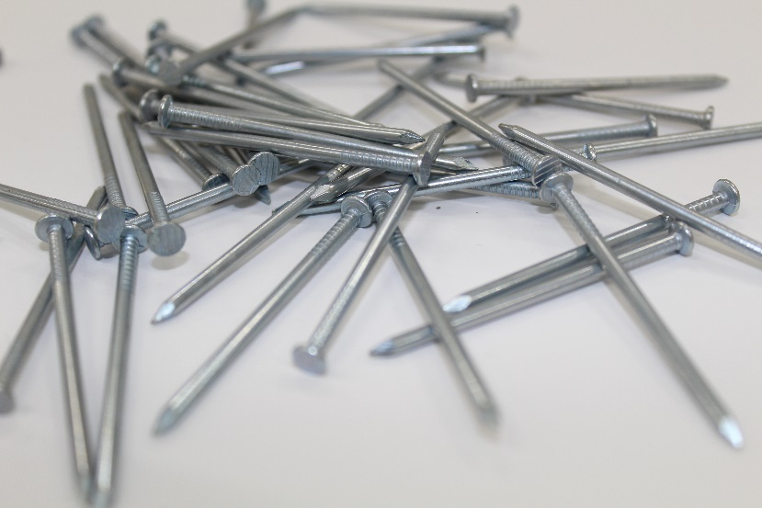
Zooming in
If you look at some nails with your eyes, this is what you may see.
You could look more closely at one nail with a magnifying glass or a microscope.
Imagine that you could zoom in even more closely.
Draw and label a diagram of what you think you would see.

